Slide 1




Course Name – Competitive Programming
Class Topic – Array & ArrayList
Instructor:
EditEdit MasterMaster texttext stylesstyles

Slide 2
Today’s Agenda
Array and ArrayList :
Minimum number of swaps to sort Array
Printing smallest k elements in the same order
Find duplicate and missing elements in O(n)
Longest Palindromic substring
Implement a stack using one queue
Find kth largest element

Slide 3
Today’s Agenda
Let’s Get Started

Slide 4
Minimum no. of swaps to sort Array
You will be given an array of n natural numbers of range (1-n) each number occurring only once. You need to find the minimum number of swaps required to make it a sorted array given that each number can be shifted at most two positions right. We can swap the elements which are adjacent.
Input: The input will be in the following format :
The first line should be the number of elements in the array.
The second line should be n elements of the array space separated.
Output: The output should be of the following format
Print the minimum number of swaps required to sort the array with given conditions.
Note: If we can’t sort the array with the given conditions print “Not Possible”.

Slide 5
Minimum no. of swaps to sort Array
Example :
Input :
5
1 2 5 3 4
Output:
2
Explanation;
Because you can shift element 5 two positions right and make it a sorted array.
Input:
8
1 2 6 3 4 5
Output:
Not Possible
Explanation: Because even if you shift element 6 two positions right you can’t make it a sorted array.
Try to code the above problem with time complexity O(n*logn).

Slide 6
Today’s Agenda
Let’s go to the Learning Portal

Slide 7
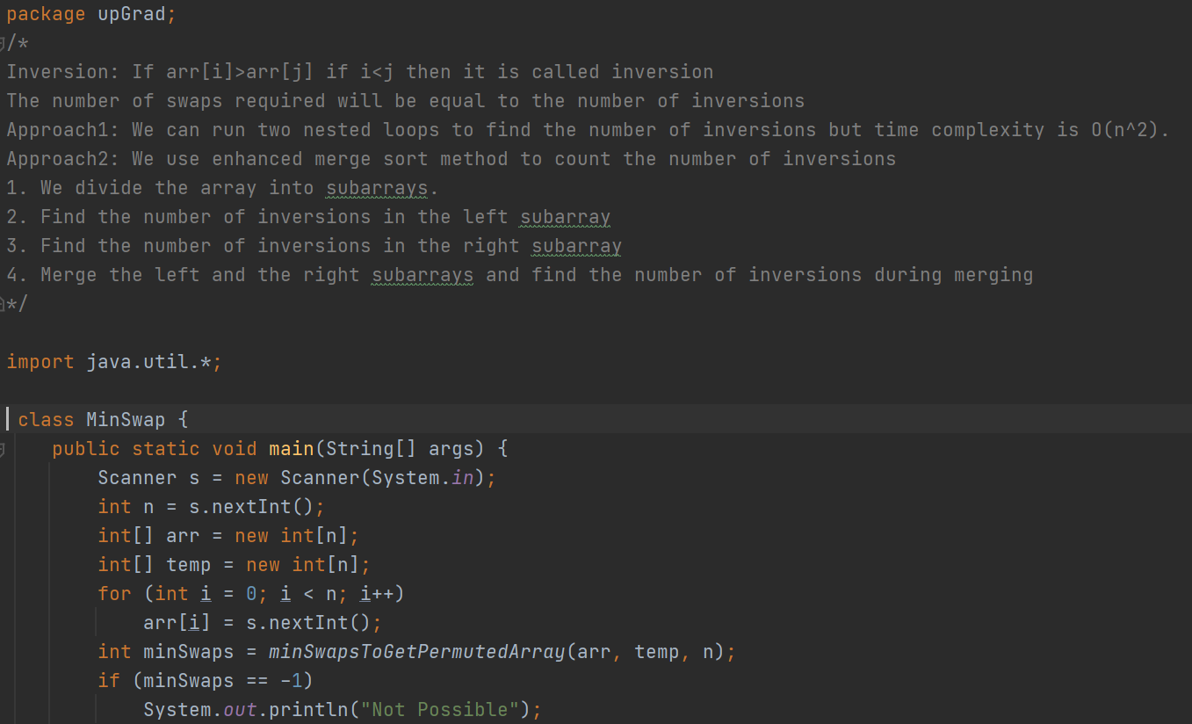
Solution : Min no. of swaps to sort Array

Slide 8
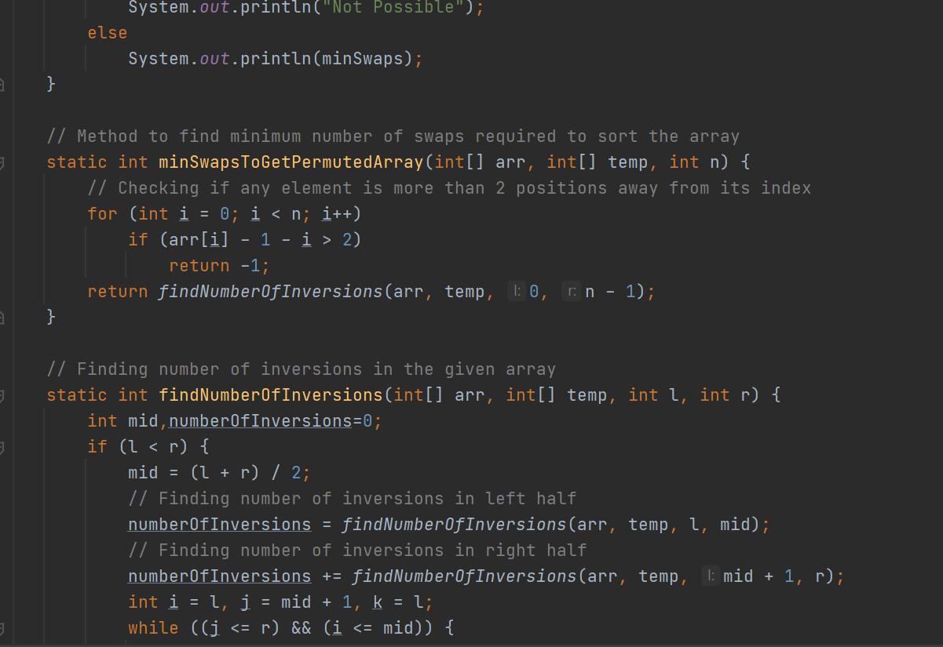
Solution : Min no. of swaps to sort Array

Slide 9
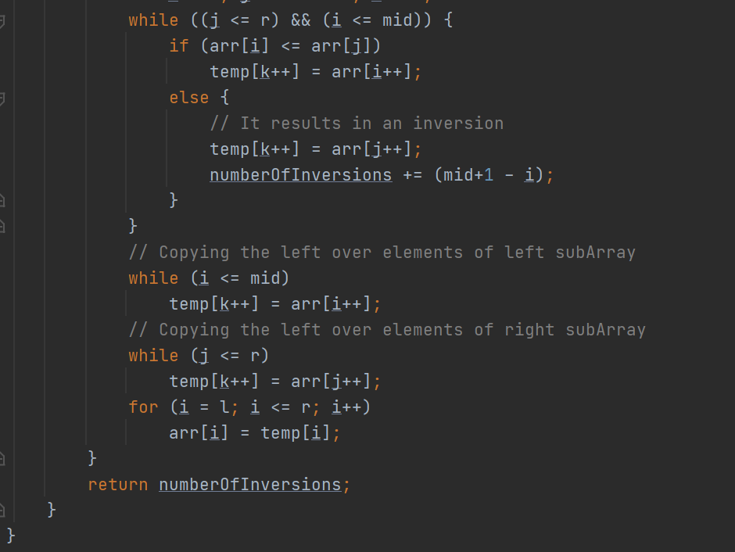
Solution : Min no. of swaps to sort Array

Slide 10
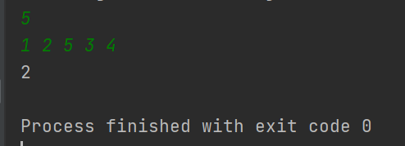
Solution : Min no. of swaps to sort Array
Output

Slide 11
Printing smallest k elements in the same order
You will be given an array of integers of size n and need to print k smallest elements in the same order as in the given array without using more than O(1) auxiliary space. The above hint will help you in retaining the order.
Input: The input will be in the following format :
The first line should be the number of elements in the array.
The second line should be the elements in the array space separated.
The third line should be number of smallest elements to be printed.
Output : The output should be of following format
Print the output values space separated.
“Invalid Input” if number of elements to be printed is more the number of given elements

Slide 12
Printing smallest k elements in the same order
Example :
Input :
9 6 2 4 8 7 1 3 0 5
4
Output:
2 1 3 0
Input:
4
5 2 8 1
7
Output:
Invalid Input

Slide 13
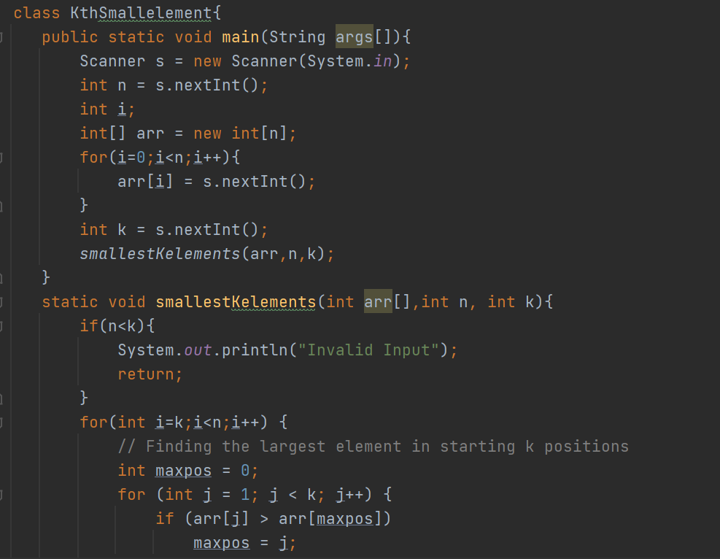
Solution : Printing smallest k elements in the same order

Slide 14
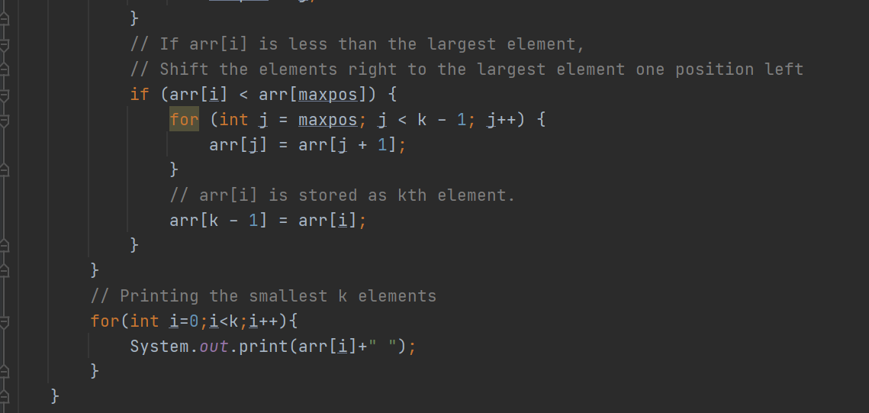
Solution : Printing smallest k elements in the same order

Slide 15
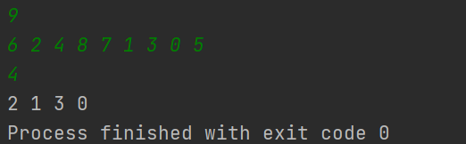
Solution : Printing smallest k elements in the same order
Output

Slide 16
Find duplicate & missing elements in O(n)
You will be given an array of integers of size n. The array contains integers of range 1 to n. Some integers may be repeated and some may be missing, find both the missing and duplicate integers.
Input: The input will be in the following format :
The first line should be the size of the array.
The second line should be the elements in the array space separated.
Output: The output should be of the following format
In the first line print, the duplicate elements space separated in increasing order.
In the second line print, the missing elements space separated in increasing order.
Note: If there are no duplicate and missing elements print “There are no duplicate integers” in the first line and “There are no missing integers” in the second line.

Slide 17
Find duplicate & missing elements in O(n)
Example :
Input :
10
1 3 4 6 7 9 10 6 3 6
Output:
3 6
2 5 8
Explanation : In given input 3 and 6 are repeating so we print that , and 2, 5 , 8 are missing (elements are from 1 to 10 in these elements 2 , 5 , 8 are missing)
So we have to print that

Slide 18
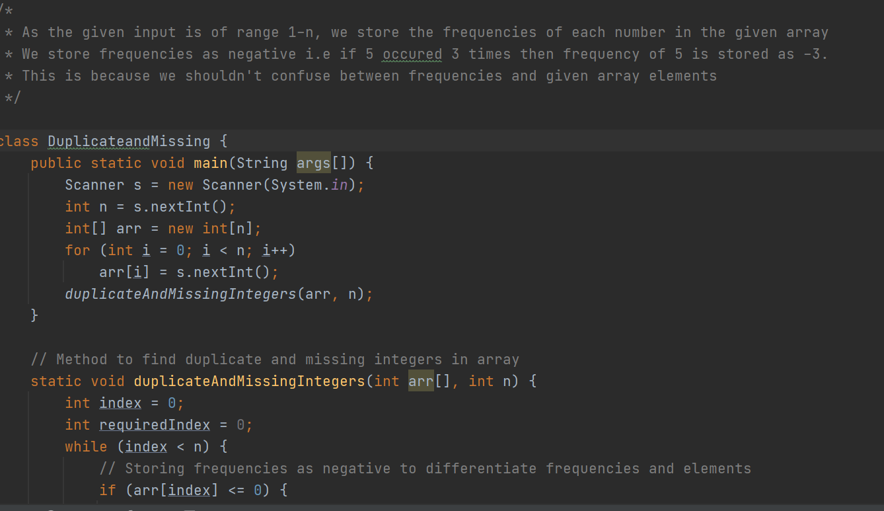
Solution :Find duplicate &missing elements in O(n)

Slide 19
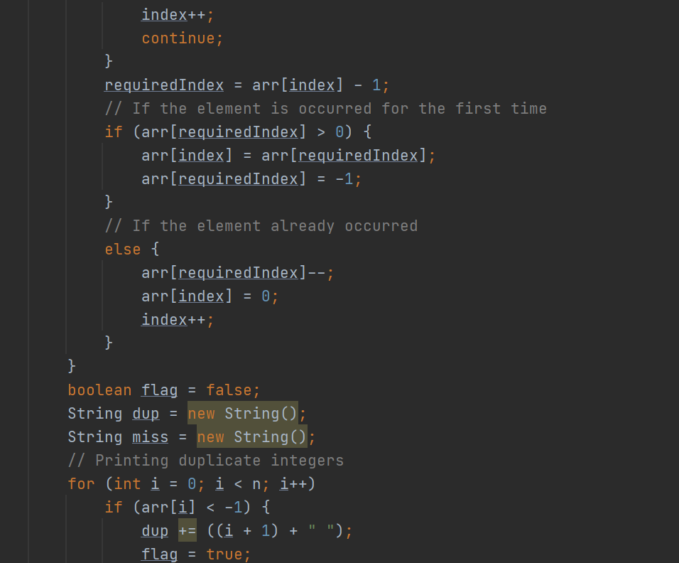
Solution :Find duplicate &missing elements in O(n)

Slide 20
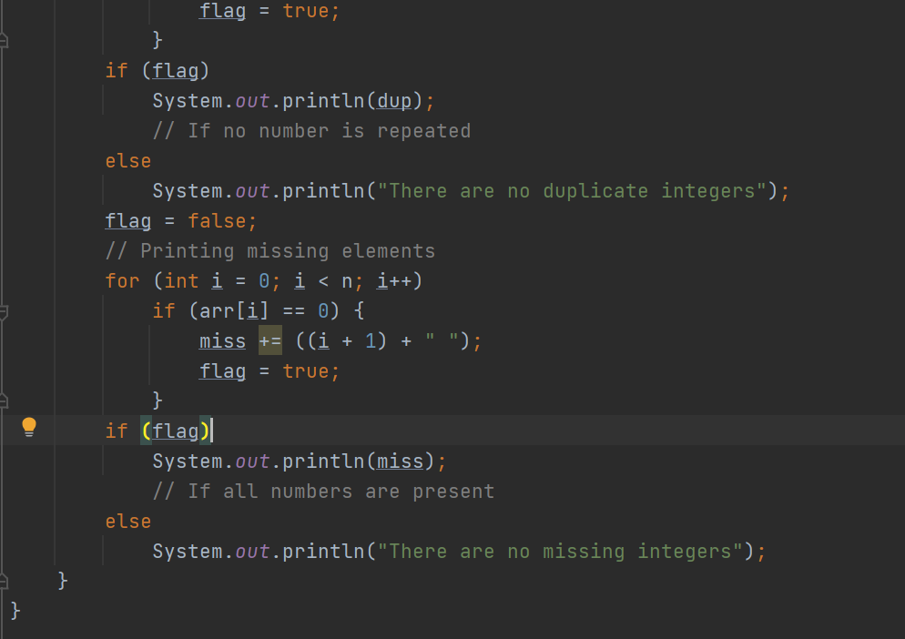
Solution :Find duplicate &missing elements in O(n)

Slide 21
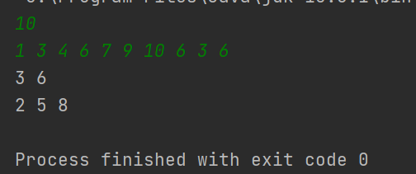
Solution :Find duplicate &missing elements in O(n)
Output

Slide 22
Longest Palindromic substring
You will be given a string, find the longest substring which is palindrome.
Example :1
Input: s = "cbbd" Output: "bb“ ,2
Explanation : In “cbbd” bb is palindrome that too longest one , and 2 represents length of that palindrome.
Example : 2
Input: s = "a" Output: "a“ , 1
Explanation: Here we have only one character in the string so ,obviously it will be the longest palindrome
And 1 represents length of that palindrome.

Slide 23
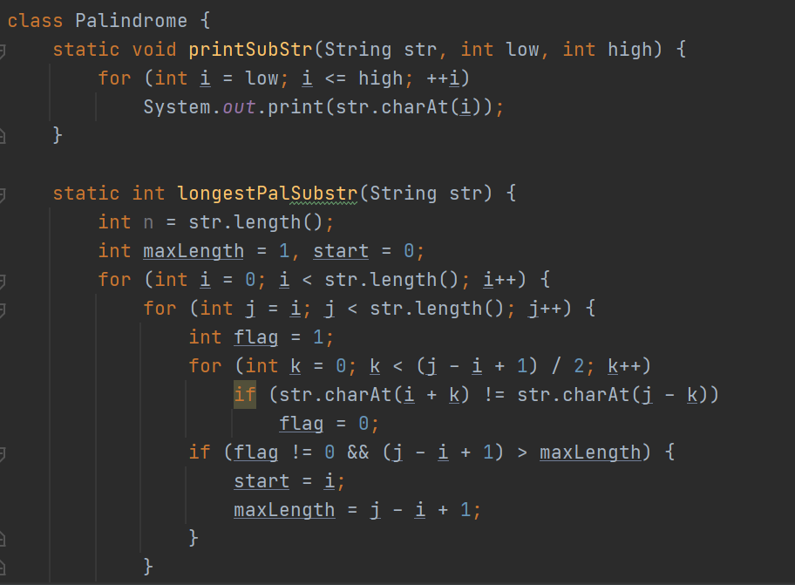
Solution : Longest Palindromic substring

Slide 24
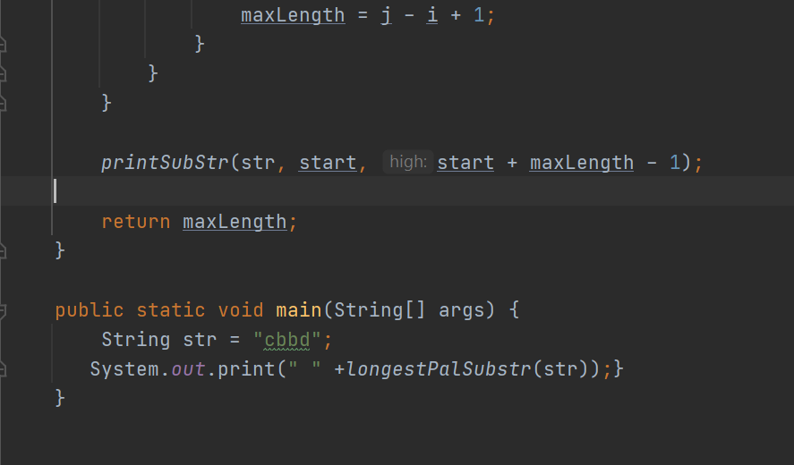
Solution : Longest Palindromic substring

Slide 25
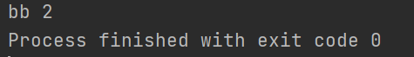
Solution : Longest Palindromic substring
Output

Slide 26
Implement a stack using one queue
You are given queue data structure, the task is to implement stack using only given queue data structure.
You have to implement the following operations :
1)Push → will add elements to stack
2)Pop → will remove from top
3) Top → Contains top value
4) isEmpty → empty or not
Input : 10 , 20 , 30
Output : 30 , 20 , 10
Explanation: Push the given input that is 10 , 20 , 30 and pop them out then O/P is 30 , 20 , 10

Slide 27
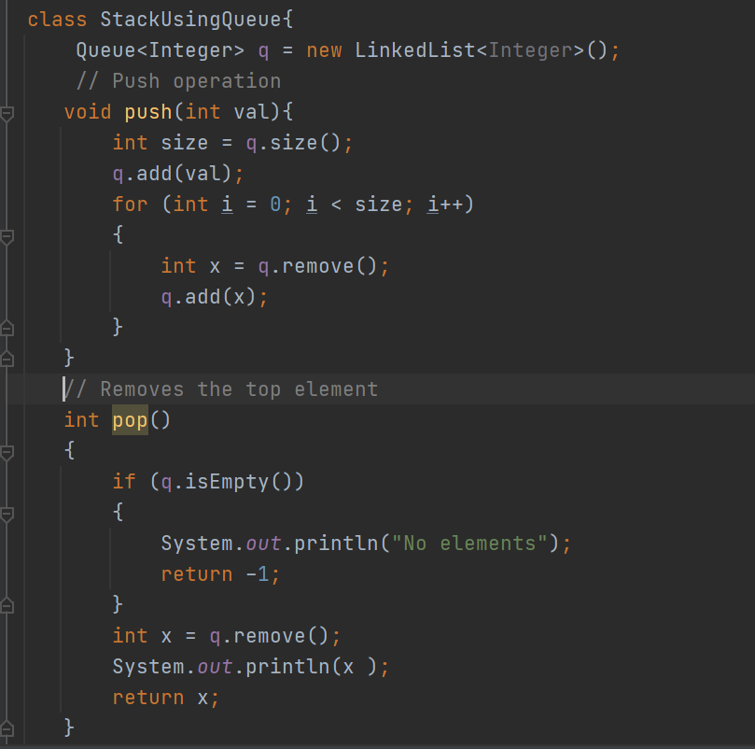
Solution : Implement a stack using one queue

Slide 28
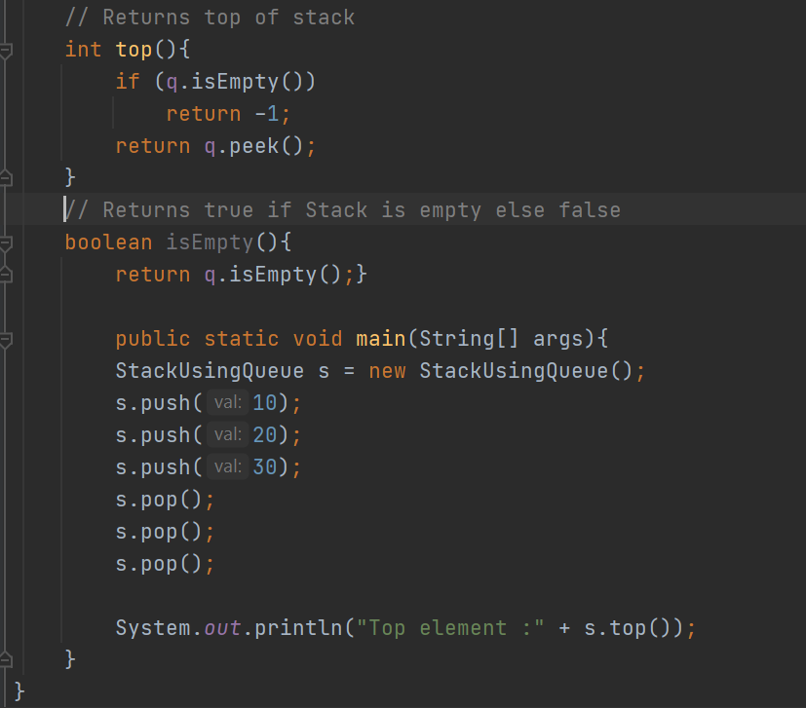
Solution : Implement a stack using one queue

Slide 29
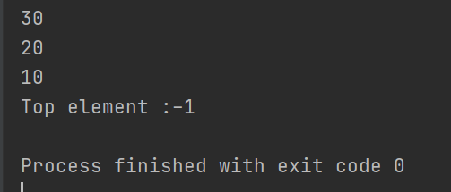
Solution : Implement a stack using one queue
Output

Slide 30
Find kth largest element
Given an array and a number k where k is smaller than the size of the array,
we need to find the k’th smallest element in the given array.
It is given that all array elements are distinct.
Examples:
Input: arr[] = {7, 10, 4, 3, 20, 15} k = 3 Output: 7
Input: arr[] = {7, 10, 4, 3, 20, 15} k = 4 Output: 10
Explanation: Find Kth element after sorting

Slide 31
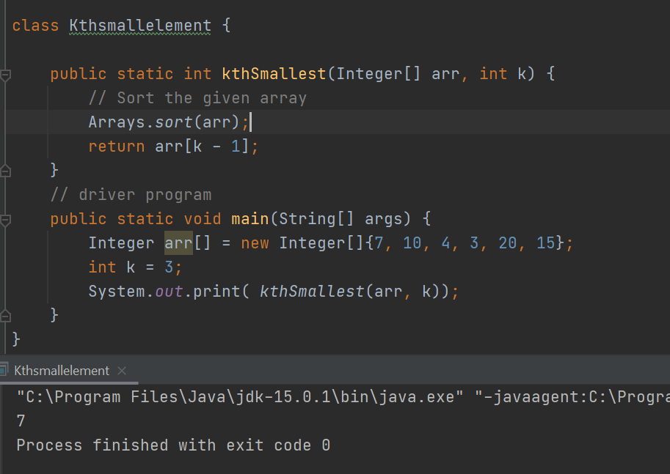
Solution : Find kth largest element

Slide 32
Today’s Agenda
Any Queries/Doubts???

Slide 33
Key Takeaways
We have learnt how to sort array with min swaps
We learnt how to Print smallest k elements in the same order
We learnt how to find duplicate and missing elements in O(n)
We learnt how to print Longest Palindromic substring
We also learnt ->Implement a stack using one queue
Also we learnt how to Find kth largest element

Slide 34
Next Day Agenda
Minimum Swaps to get the sorted Array
Printing smallest k elements in the same order
Find duplicate and missing elements in O(n)
Longest Palindromic substring
Implement a stack using one queue
Find kth largest element

Slide 35

Thank you for Attending!
#SirfNaamKiNahinKaamKiDegree

